Slide 1
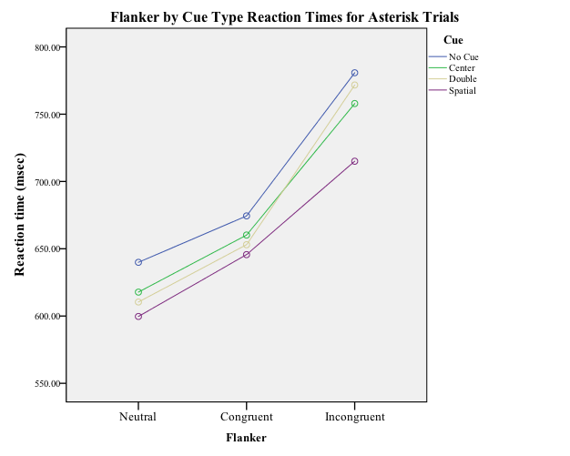
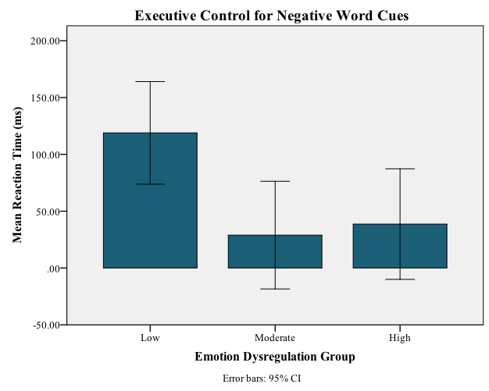
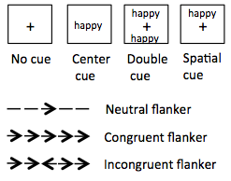
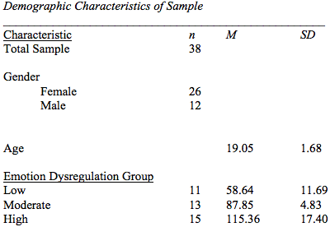
Mechanisms of Emotion Regulation:
The Role of Attentional Control
Lindsey R. Wallace, M. A. & Elisabeth J. Ploran, Ph.D.
Department of Psychology, Hofstra University
Contact: lwallace1@pride.hofstra.edu
Introduction
Test of ANT-E in Emotion Regulation Groups
Results
Emotion dysregulation is increasingly being viewed as a transdiagnostic process underlying psychological disorders. Previous research has examined the hypothesis that dysfunctional forms of emotion regulation are related to deficits in attentional control, in that the inability to shift attention away from emotionally arousing stimuli may be a key mechanism in emotion dysregulation (Fajkowska & Derryberry,2010).
Using the Attention Network Test (ANT; Fan, McCandliss, Sommer, Raz, & Posner, 2002), Tortella-Feliu et al. (2014) showed that dysfunctional emotion regulation strategies are related to attentional network functioning in emotionally neutral conditions.
The present study attempts to improve the ANT by (1) including emotionally salient cues (i.e., negative, neutral and positive words) and (2) examining whether individuals with emotion regulation deficits respond differently to the task (i.e., ANT-E) compared to those without such deficits.
Replication of Fan et al. (2002)
All analyses were conducted on reaction times in milliseconds on correct trials only.
Reaction times in the emotion word cue conditions did not significantly differ from one another, F(2, 74) = 0.62, p = 0.54.
A 3 x 3 x 3 x 3 (Group x Flanker type x Cue type x Word type) mixed ANOVA revealed that there were no significant differences between Groups, F(2, 35) = 0.05, p = 0.95.
Participants in the low group displayed poorer executive control in the presence of negative words (M = 118.90) compared to those in the high group (M = 38.62) and the moderate group (M = 28.95).
Participants were recruited from the Hofstra University undergraduate psychology research pool and completed the Difficulties in Emotion Regulation Scale (DERS; Gratz & Roemer, 2004) as a screening measure.
Participants were invited to participate in the study based on their scores on the DERS and then categorized into low, moderate, and high emotion dysregulation groups based on their scores.
Participants attended one test session in which they completed the ANT-E.
ANT-E Test Procedure:
Emotional Valence
Reaction times for overall word cues were not statistically different from reaction times to asterisk cues, F(1, 37) = 3.06, p = 0.09.
A 3 x 3 x 3 (Flanker Type x Cue Type x Word Type) within-subjects ANOVA revealed a main effect of Flanker Type, F(1.70, 74) = 16.8, p < 0.001, of Cue Type, F(1.71, 74) = 16.12, p < 0.001, but not a main effect of Word type, F(2, 74) = 2.12, p = 0.13.
Based on Fan et al. (2002) & Ainsworth et al. (2013)
Norming Study
Discussion
Directions for Future Research
Five-letter words were first chosen from the MRC Psycholinguistic Database for frequency, familiarity, and part of speech. Then these words were cross-referenced to the Affective Norms for English Words (ANEW) for valence, arousal, and dominance. Ninety were chosen and then categorized into negative, neutral, and positive valence groups.
Participants were recruited through Mechanical Turk to rate the words on valence and arousal. A total of 60 words (i.e., 20 in each category) were then chosen based on valence and arousal to replace the neutral asterisk cue in the ANT to create an ANT-E.
Overall results of ANT-E for asterisk cues replicated findings of Fan et al. (2002).
Contrary to hypotheses, word cues did not alter participants’ reaction times compared to asterisk cues, and there was no difference between word cues across participants.
Alerting and Orienting scores were similar across word cues and groups.
Executive Control scores for negative words differed between the low group, and both the moderate and high group, suggesting poorer executive control in the presence of an initial negative stimulus for those with better emotion regulation skills.
Alter task to either include emotionally salient photos prior to each stimulus presentation or include a mood induction procedure prior to ANT.
Compare ANT-E between clinical and non-clinical populations on emotion regulation and other regulatory strategies (e.g., thought suppression and rumination).
Participant Characteristics
References
Fajkowska, M., & Derryberry, D. (2010). Psychometric properties of attentional control scale: The preliminary study on a polish sample. Polish Psychological Bulletin, 41(1), 1–7.
Fan, J., McCandliss, B. D., Sommer, T., Raz, A., & Posner, M. I. (2002). Testing the efficiency and independence of attentional networks. Journal of Cognitive Neuroscience, 14(3), 340–347.
Gratz, K. L., & Roemer, L. (2004). Multidimensional assessment of emotion regulation and
dysregulation: Development, factor structure, and initial validation of the difficulties in emotion regulation scale. Journal of Psychopathology and Behavioral Assessment, 26(1), 41–54.
Tortella-Feliu, M., Morillas-Romero, A., Balle, M., Bornas, X., Llabrés, J., & Pacheco-Unguetti, A. P. (2014). Attentional control, attentional network functioning, and emotional regulation styles. Cognition and Emotion, 28(5), 769-780.

